Slide 1
Attacks and Defenses of Wireless Sensor Networks
Jason Li
Jeremy Fowers

Slide 2
Agenda
Background Information
Wireless sensor network characteristics
General sensor network security mechanisms
DoS attacks and defenses
Physical layer
Link/MAC layer
Network layer
Transport layer
Application layer
Questions

Slide 3
Denial-of-Service in Wireless Sensor Networks: Attacks and Defenses
David R. Raymond, Scott F. Midkiff
Virginia Tech University
Raymond, D.R.; Midkiff, S.F.; , “Denial-of-Service in Wireless Sensor Networks: Attacks and Defenses,” Pervasive Computing, IEEE, vol. 7, no. 1, pp. 74-81, Jan.-March 2008

Slide 4
Background Information
Expansion of WSN applications highlight the need for better security
Medical monitoring
Homeland security
Industrial automation
Military applications
Computer and network security aim to provide
Confidentiality: prevent unauthorized access
Data integrity: communications are unaltered and not repeated
Service availability: authorized parties can access on request

Slide 5
Denial of Service (DoS)
DoS attacks target service availability
Problematic for many network types
Prevents communication between devices
Disables a targeted device
Denial-of-sleep
Specific to energy-constrained embedded systems
Motes commonly sleep their power-hungry radios
Attacks force radios to remain active
Can reduce battery life by orders of magnitude

Slide 6
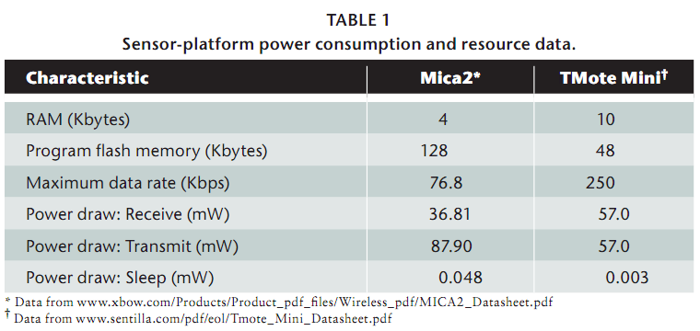
WSN Characteristics
Weaknesses of WSNs
Limited processing capability and memory
Inability to secure wireless medium
Sensors are vulnerable to physical tampering
Face attackers who aren’t limited by resources
Limited and often non-replenishable power supplies

Slide 7
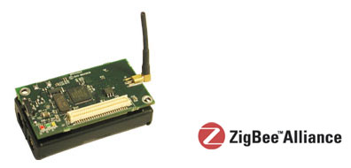
General Security Mechanisms
Security Protocols for Sensor Networks
TinySec
IEEE 802.15.4 or ZigBee specifications

Slide 8
Security Protocols for Sensor Networks (SPINS)
Characteristics of SPINS
Broadcast authentication
Two-party authentication
Data confidentiality
Symmetric vs. public-key cryptography
Uses shorter encryption keys and requires less computation
Data freshness for unicast messages
Antireplay counters are incremented when packet is sent or received
Transmits a calculated message authentication code
Packet drops if authentication fails and requires expensive recovery
Unrealistic for memory-constrained sensor nodes

Slide 9
TinySec
TinySec characteristics
Packet authentication and encryption
Included in TinyOS version 1.1
Low overhead
Authentication increases per packet power consumption by only 3 percent
Encryption increases per packet power consumption by only 10 percent
Supports network-wide, cluster-wide, pair-wise encryption keys
Limitations
Doesn’t protect against message replay
No specific protection against resource consumption attacks

Slide 10
ZigBee
Details physical and MAC layer requirements for wireless radios
Provides hardware support for data confidentiality by use of AES encryption
Advanced Encryption Standard
State-of-the-art symmetric cryptography protocol
Access control
Data encryption
Packet authentication
Optional antireplay counters
Attacks on ZigBee
Same-nonce attack¹ to break confidentiality by using same encryption key

Slide 11
DoS attacks and defenses
We restrict the Open System Interconnect model down to 5 layers from 7
Physical layer
Link/MAC layer
Network layer
Transport layer
Application layer
Analyze each for attacks and potential defenses

Slide 12
Physical Layer - Jamming
Jamming-primary physical attack
Constant: high power, random noise
Deceptive: high power, sends byte traffic
Random: low power, sleeps to save energy
Reactive: low power, jams in response to traffic
Problem: simple radios have limited spectrum
Cannot use classic spread-spectrum technique
Defense: detect and sleep
Secondary defense: detect and reroute

Slide 13
Physical Layer – Tampering
Physical attack on the node itself
Problem: nodes often deployed in unsecured areas
No way to prevent for sure, defenses include:
Camouflage
Tamper-proof packaging
Redundant nodes
Tamper reaction (fire safe)

Slide 14
Link Layer Attacks
Attack MAC protocols operating the link layer
Collision: identical to jamming
Interrogation: constantly request-to-send
Packet replay: record legitimate traffic and replay
Problem: Very susceptible to DoS because MAC controls power-hungry radio HW
Reduces battery life by orders of magnitude

Slide 15
Link Layer Defenses
Link-layer authentication
Ensure communication with trusted parties
Problem: replaying trusted communication
Antireplay support
Ensure packets are only sent and received once
Problem: checking for replays still uses energy
Jamming detection
Sleep to counter stream of replayed messages

Slide 16
Network Layer Attacks
Attack the routing protocol between nodes
Hello flooding
Nodes send “hello” to one-hop network
Attacker replays “hello” with high power antenna, creates false one-hop network
Doesn’t require encryption breaking
Defense: pairwise authentication, geographic routing (both very expensive)

Slide 17
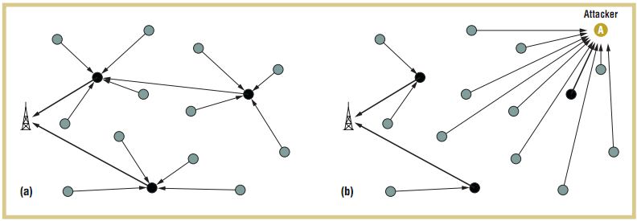
Network Layer Attacks cont.
Head node volunteering
Nodes cluster to save power, use one head node
Attacker volunteers to be head node, drops packets
Defense: None suitable for embedded so far

Slide 18
Network Layer Attacks Cont.
Homing Attacks
Analyze traffic for special nodes (cluster heads, key managers)
DoS special nodes to shut down entire network
Defense: header encryption, dummy packets (obscure network traffic)
Black Hole Attack
Become part of many routes, drop all packets
Defense: authentication, antireplay

Slide 19
Transport Layer
TCP manages end-to-end connections
Uses memory to store state information
Flooding attack
Open many connections to overflow state buffer
Defense: SYN cookies (client maintains state)
Desynchronization attack
Sends bogus sequence numbers or controls flags
Defense: authentication

Slide 20
Application Layer
Attack by sending large amounts of stimuli
Applications are controlled by stimuli
i.e. send alert for motion detection
Causes large amounts of network traffic
Defense: filter data alerts, limit alert rate
Network-programming attack
Nodes can be reprogrammed in the field
Attack by sending false program
Defense: break program into parts, each part has hash of next part

Slide 21
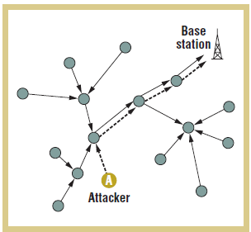
Application Layer cont.
Path-Based DoS
Forward packets all the way to base station
Use network bandwidth, node energy
Defense: authentication and antireplay

Slide 22
Conclusion
Encryption and authentication defend against many attacks
Jamming detection also necessary
Low overhead antireplay protocol needed
Denial of Sleep attack must be taken seriously
Any questions?

